Slide 1
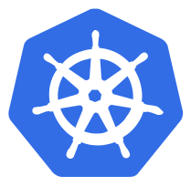
Health Checks
If your application malfunctions, the pod & container can still be running, but the application might not work anymore.
To detect & resolve problems with your application, you can run health checks
You can run 2 different type of health
Running a command in the container periodically
Periodic checks on the a URL ( HTTP)
The Typical production application behind a load balancer should always have health checks implemented in some way to ensure availability & resiliency of the app.

Slide 2
Demo Placeholder
Performing health checks

Slide 3


